Slide 1
Object Oriented Programming Lab CSE 1206
Lab 6

Slide 2
Course Teacher Dr. Shahriar Mahbub, Associate Professor Nowshin Nawar Arony, Adjunct Lecturer

Slide 3
Inheritance in Java is a mechanism in which one object acquires all the properties and behaviors of a parent object.

Slide 4
Inheritance
Class that is inherited is called SUPERCLASS
Class that does the inheriting is called SUBCLASS
Syntax: using extends keyword
class Subclass-name extends Superclass-name
{
//methods and fields
}

Slide 5
Single Level Inheritance

Slide 6

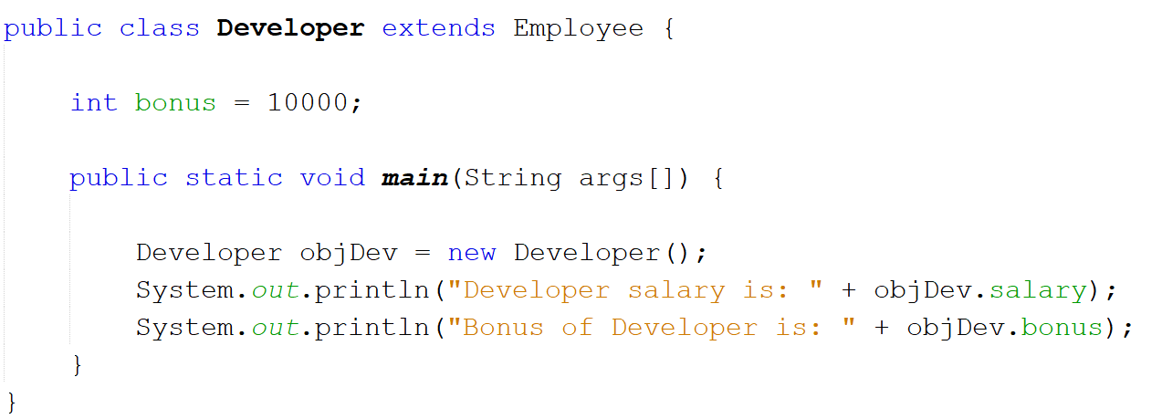
Super Class
Sub Class

Slide 7
Create a project with whatever name you want to. It will be the main class. Then create the following inheritance.

Slide 8
Super Class Name: Shape
Variables: color (String), filled (Boolean) Two constructors: - a no-argument constructor that initializes color =“white” and filled = true - parameterized constructor.
Sub Class Name: Circle
Variables: radius (double) Three constructors: a no-argument constructor that initializes the radius = 1.0 A parameterized constructor with only radius as parameter. - Another parameterized constructor with radius, color and filled

Slide 9
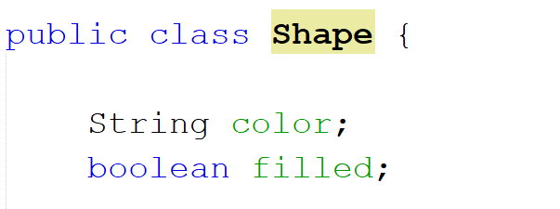
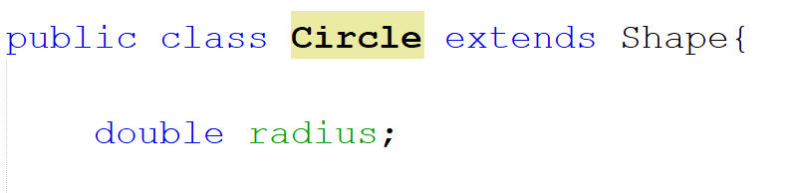
Super Class
Sub Class

Slide 10
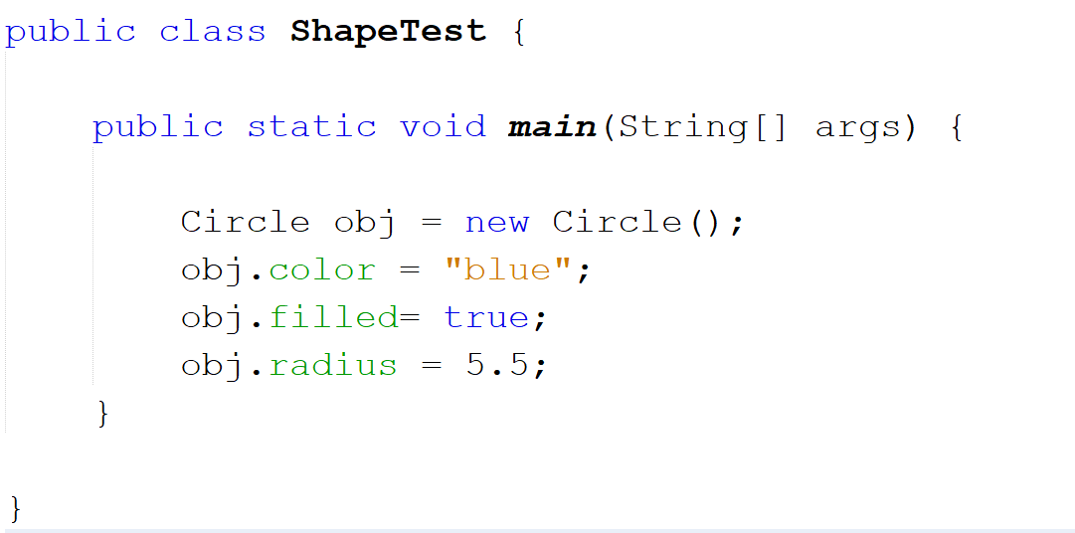
Testing the Inheritance in Main Class

Slide 11
Hierarchical Inheritance

Slide 12
Super Class : Shape
Sub Class Name: Rectangle
Variables: length (double), width (double) Three constructors: a no-argument constructor that initializes the length = 1.0, width = 1.0 A parameterized constructor with only length, width as parameter. - Another parameterized constructor with length, width, color and filled

Slide 13
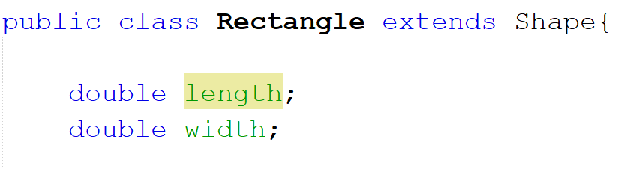
Sub Class 2 of Super Class Shape

Slide 14
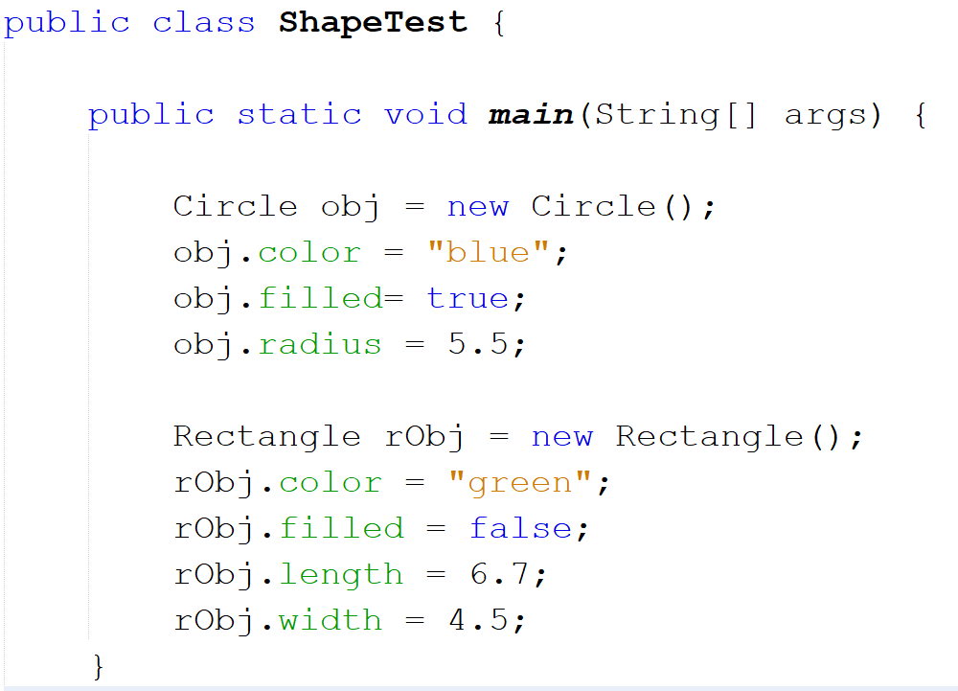

Slide 15
Multilevel Inheritance

Slide 16
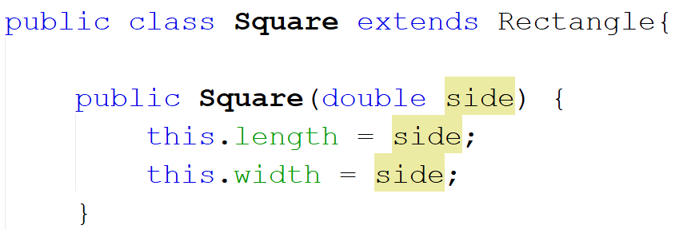

Slide 17
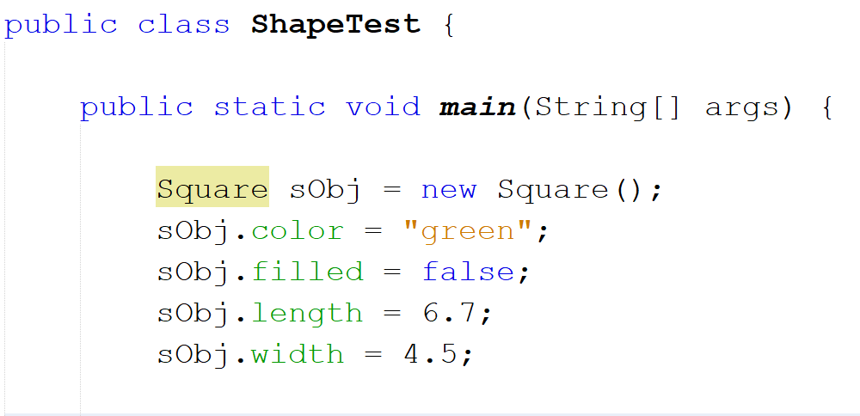

Slide 18
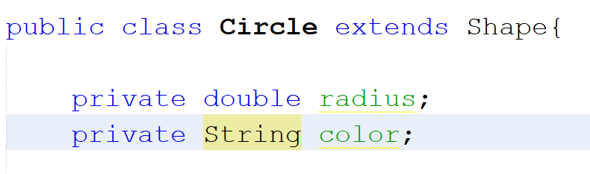
If both super class and sub class have a variable with same name

Slide 19
Super keyword is quite similar to the use of this keyword.

Slide 20
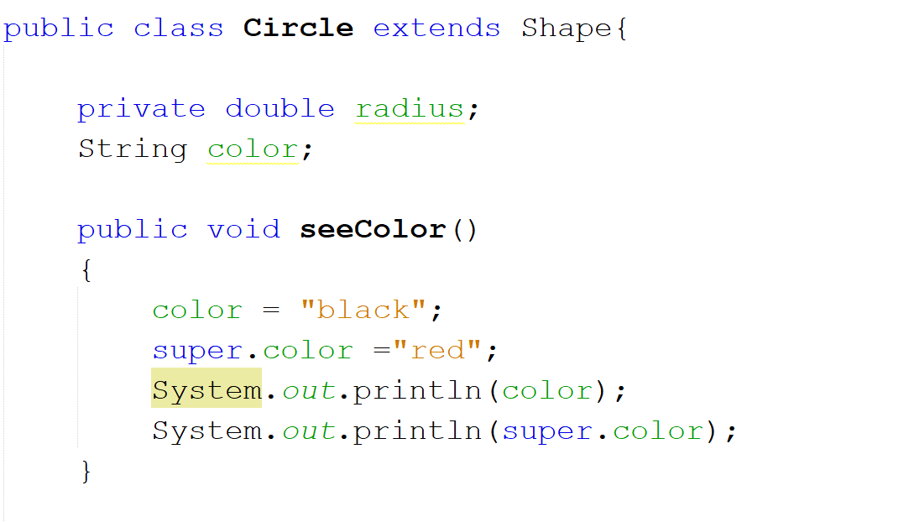

Slide 21
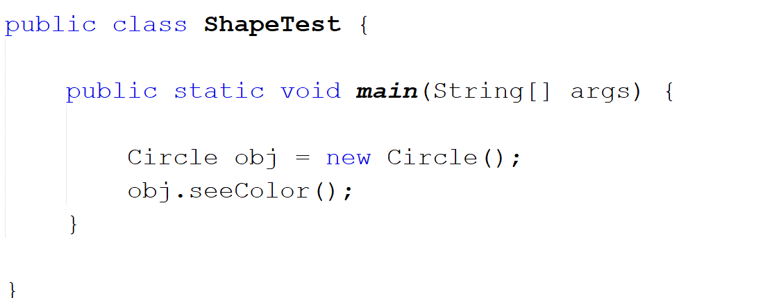
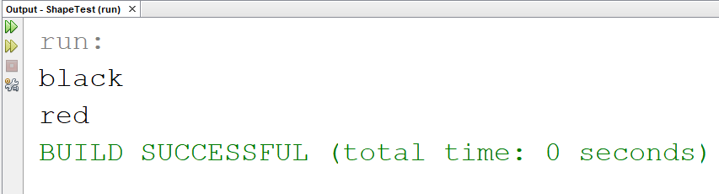

Slide 22
A private member is not accessible by the sub classes.

Slide 23
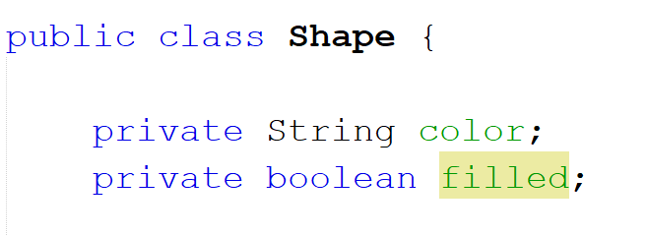
Create the getter setter methods.

Slide 24
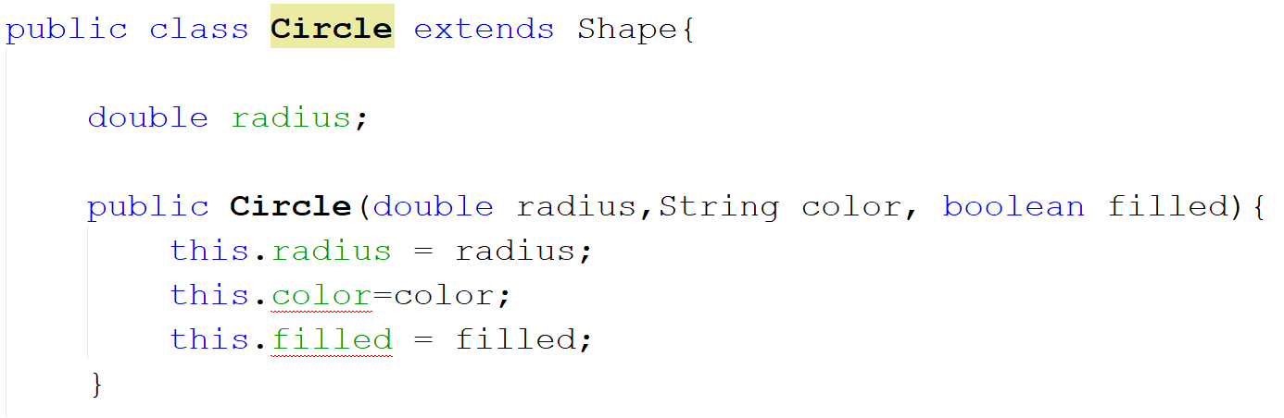
Error:
Legs has private access in Animal

Slide 25
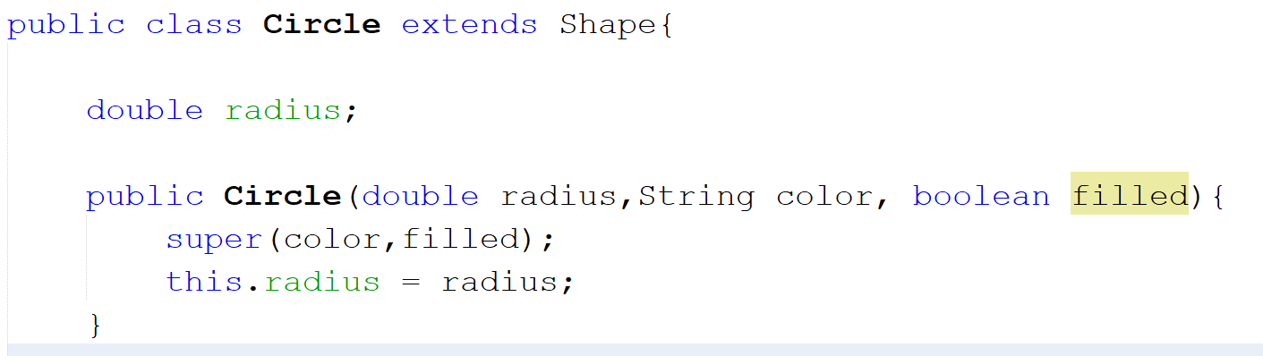
Solution

Slide 26
- Now convert all variables in all classes to private - declare getter setter methods for each variable - Use super wherever needed.

Slide 27
Method Overriding
If subclass (child class) has the same method as declared in the parent class, it is known as method overriding.
Rules for Java Method Overriding
1. method must have same name as in the parent class
2. method must have same parameter as in the parent class.
3. must be in a relationship (inheritance).

Slide 28
- Now go to Shape - Create a method named calculateArea() whose return type is double and has no parameter. - return 1.0;

Slide 29
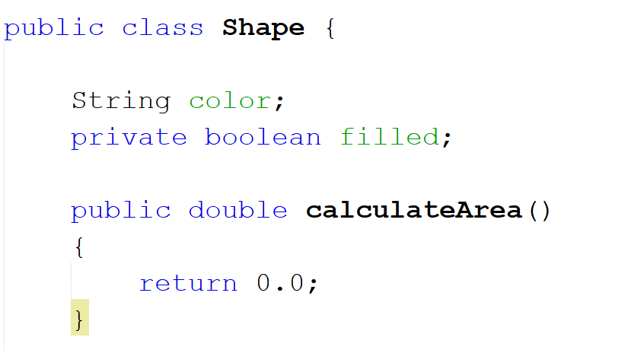
Now override this method in Circle, Rectangle and Square class

Slide 30
Now go to main class create objects for Shape, Circle, Rectangle and Square classes. Then call the calculateArea() method for each object and print.

Slide 31
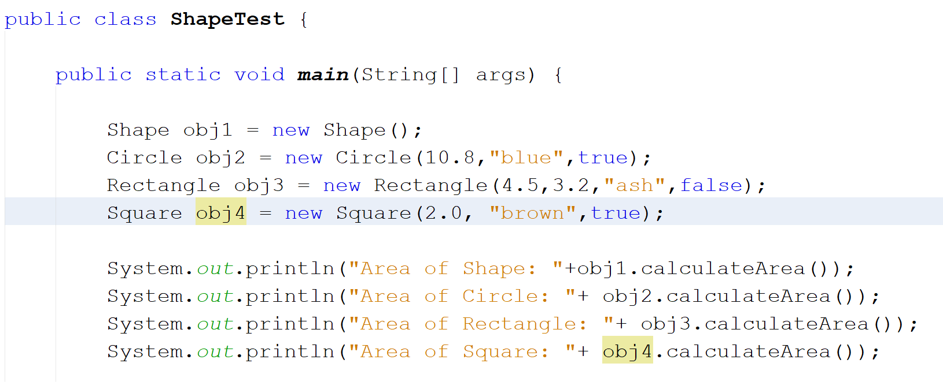

Slide 32
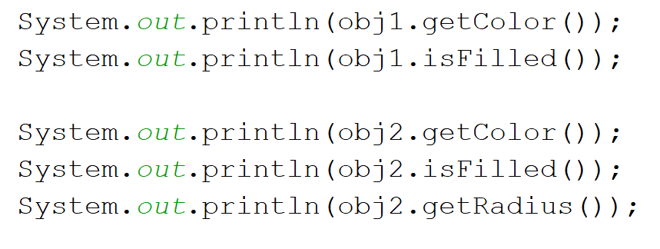
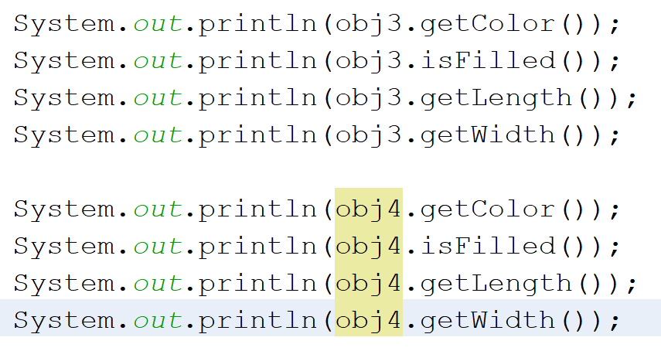
Printing all the values

Slide 33
Real example of Java Method Overriding
Consider the following scenario:
Bank is a class that provides functionality to get rate of interest. But, rate of interest varies according to banks. For example,
BRAC, DBBL and HSBC banks could provide 8%, 7% and 9% rate of interest respectively.

Slide 34
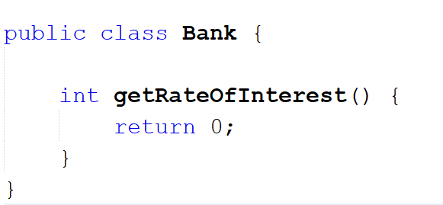
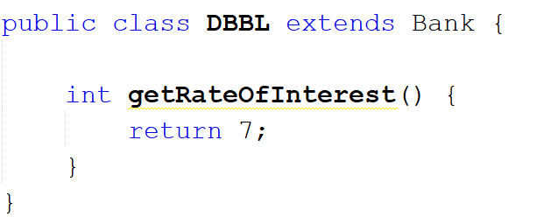
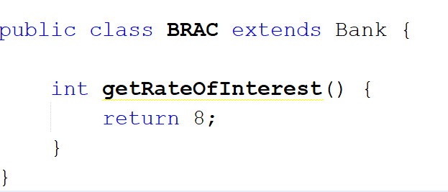
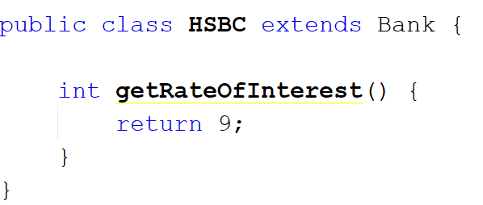

Slide 35
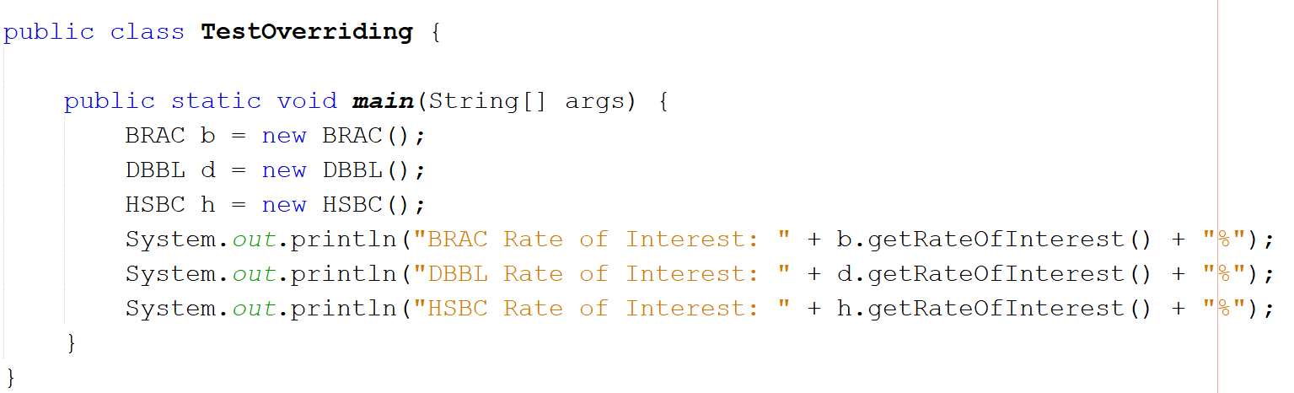
Test the method Overriding

